Slide 1

Arena Integration and Customization
Chapter 10
Last revision July 14, 2003

Slide 2
What We’ll Do ...
Reading and Writing Data Files (ReadWrite)
ActiveX™ and Visual Basic® for Applications (VBA)
Creating Modules with Arena Professional Edition

Slide 3
Reading and Writing Data Files
Reading entity arrivals from a text file
Reading and writing Microsoft Access
and Excel files
Advanced reading and writing

Slide 4
Reading Entity Arrivals From a Text File
Why data-driven simulations?
  Model validation
  Evaluating how a particular scenario is handled
  Modeling a specific arrival pattern
  Assumes historical data exist and can be transformed for use in simulation

Slide 5
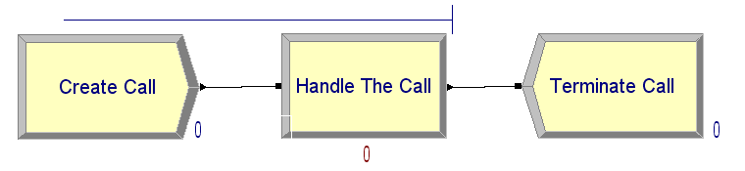
Simple Call Center Model
Single call stream
Single agent resource
Random call processing time

Slide 6
External Call Center Data
Historical call arrival times
Model 10-02 Input.txt
  ASCII file (e.g., Notepad, saved as text from Excel)
  Absolute simulation arrival times
    1.038457
    2.374120
    4.749443
    9.899661
    10.525897
    17.098860

Slide 7
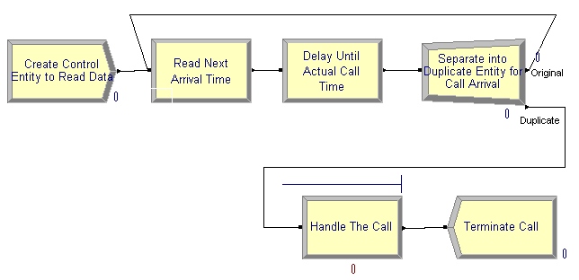
Model Logic to Read Data
Can’t use simple time between arrivals
Control entity
  Create only one
  Duplicate to send actual “call” entity into model
Control Entity
Actual “Call” Entity

Slide 8
Model Logic to Read Data (cont’d.)
ReadWrite module (Advanced Process)
  Arena File Name: description (actual disk filename is specified in File module)
  Assignments: model variables/attributes to be assigned based on data read from file (Call Start Time attribute)
Delay/Duplicate Logic
  File contains “absolute” times; Delay module holds entity for a time interval
  Delay control entity for interval until actual arrival time of call (Call Start Time - TNOW)
  Create a duplicate (Separate module) to dispatch actual call into model. Original entity loops back to read next time.

Slide 9

Model Logic to Read Data (cont’d.)
File data module (Advanced Process)
  Name: Name referenced in other Arena modules.
  Access Type: Sequential indicates to read in order.
  Operating System File Name: The name used by file system. May be relative or fully qualified.
  End of File Action: What to do when all records are read.

Slide 10
Run Termination
Run Setup options
  Maximum replications / simulation end time always terminates the simulation run.
System empties
  If no entities on calendar and no other time-based controls, run may terminate earlier than setup options dictate.
  The control entity is disposed after it reads the last data value.

Slide 11
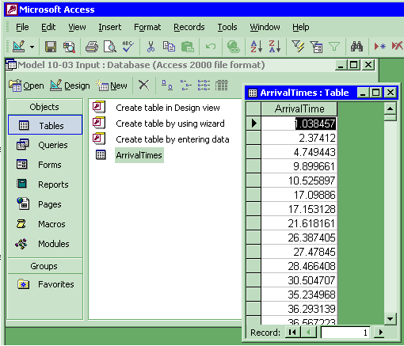
Reading Access Files
Sample Access data
  Model 10-03 Input.mdb
  Table: ArrivalTimes

Slide 12

Reading Access Files
File data module (Advanced Process)
  Access Type: Microsoft Access (*.mdb)
  Operating System File Name: Model 10-03 Input.mdb
  Recordsets: Click to load the Recordsets Editor
Important:
  Never name an access file the same as the model name or it will conflict with the automatic output database file.

Slide 13
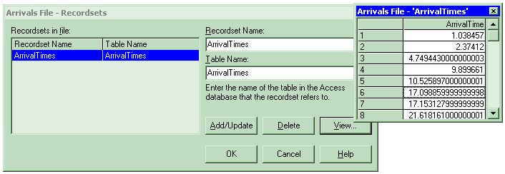
Reading Access Files
Recordsets Editor
  Associates a recordset name with a table
  Table must already exist
  View allows you to see a sample of the real data

Slide 14
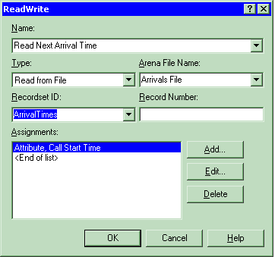
Reading Access Files
ReadWrite module (Advanced Process)
  Recordset ID: Same as defined in Recordsets Editor

Slide 15
Reading Excel Files
Excel is not a relational database but has many similarities:
  An Excel workbook is similar to an Access database file.
  The rows and columns in a rectangular named range in an Excel worksheet are similar to the rows and columns of an Access table.

Slide 16
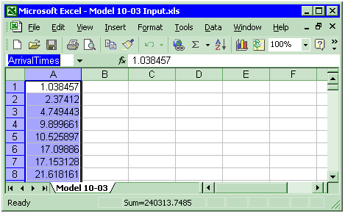
Reading Excel Files
Sample Excel data
  Model 10-03 Input.xls
  Named Range: ArrivalTimes

Slide 17

Reading Excel Files
File data module (Advanced Process)
  Access Type: Microsoft Excel (*.xls)
  Operating System File Name: Model 10-03 Input.xls
  Recordsets: Click to load the Recordsets Editor

Slide 18
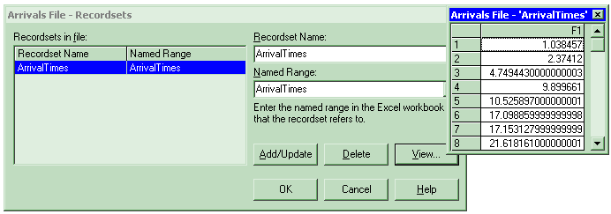
Reading Excel Files
Recordsets Editor
  Associates a recordset name with a named range
  Named range must already exist
  View allows you to see a sample of the real data

Slide 19
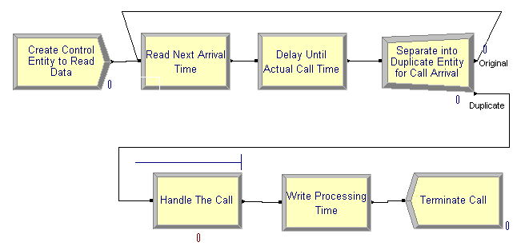
Writing Access and Excel Files
The file:
  The table or named range must already exist.
  An Excel named range should be formatted as numeric.
ReadWrite module:
  Add new module to specify which data to write.

Slide 20
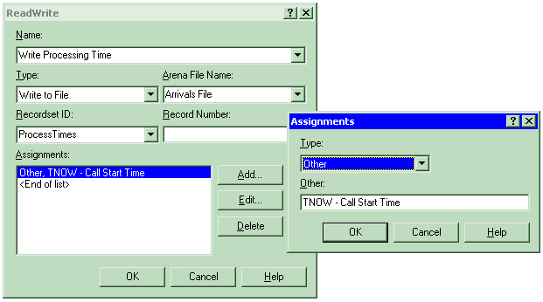
Writing Access and Excel Files
ReadWrite module:
  Use Type of Write To File
  Use Recordset ID as before.

Slide 21
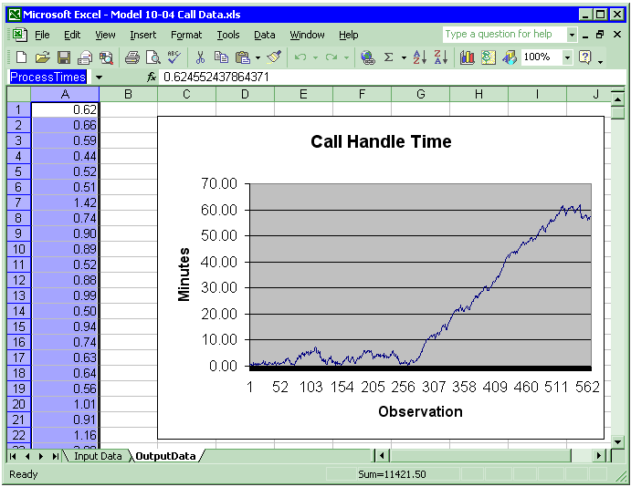
Writing Access and Excel Files
Spreadsheet options:
  You may predefine a plot on the named range and the plot will be built dynamically as data is added to the file.

Slide 22

Advanced Reading and Writing
Formatting can be used to handle text files with fields not delimited by spaces:
Part 1 1.038
Part 27 2.374
Part 5194.749
Part 67 9.899
Part 72 10.52
Part 16217.09

Slide 23
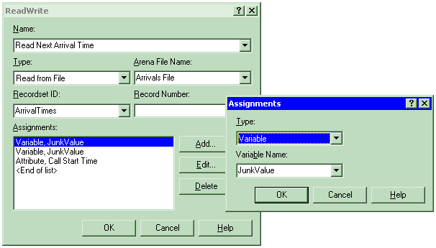
Advanced Reading and Writing
Skip columns in Access & Excel by using dummy variables:

Slide 24
Advanced Reading and Writing
Advanced data access is available using Access Type of Active Data Objects (ADO) and a Connection String:
  Excel With Headings Using ADO
  SQL Commands Using ADO
Provider=Microsoft.JET.OLEDB.4.0;
Data Source=C:\Documents\Book1.xls;
Extended Properties=””Excel 8.0; HDR=Yes;””
Use two double quotes for each embedded double quote
Driver={SQL Server};
Server=RSI-Joe; Database=BizBikes;
Uid=BizWareUser; pwd=MyPassword

Slide 25
What We’ll Do ...
Reading and Writing Data Files (ReadWrite)
ActiveX™ and Visual Basic® for Applications (VBA)
Creating Modules with Arena Professional Edition

Slide 26
ActiveX Automation
Program applications to “automate” tasks
  Act on themselves (e.g., macros in Excel)
  Act on other applications (e.g., Arena creating Excel file)
External programming languages
  C++, Visual Basic®, Java, etc.
Visual Basic for Applications (VBA) programming embedded in application
  Microsoft Office®, Visio®, AutoCAD®, Arena®, …
Both types work together (e.g., Arena VBA controlling Excel)

Slide 27
Application Object Model
Objects: application components that can be controlled
Properties: characteristics of objects
Methods: actions performed on or by objects
  Arena Objects Properties Methods
  Application Visible Show
  Model Name, State Close, Go
  View Background Color Zoom In
  …

Slide 28
Visual Basic for Applications (VBA)
Included with Arena
Full Visual Basic programming environment
Code stored with Arena model (.doe) file
UserForms (dialogs) for custom interfaces
Code-debugging tools
Comprehensive online help
Visual Basic Editor window: “child” of Arena (Tools/Show Visual Basic Editor)

Slide 29
Built-in Arena VBA Events
ThisDocument: accesses objects, events in Arena’s object model
Built-in VBA events: locations where VBA code can be activated
  Pre-run events (e.g., DocumentOpen)
  Arena-initiated run events (e.g., RunBegin, RunEndReplication)
  Model/user-initiated run events (e.g., UserFunction, VBA_Block_Fire)
Type code in Visual Basic Editor to populate an event

Slide 30
Simulation Run VBA Events
Arena/VBA sequence of events when model runs:
1. RunBegin
Module data available
2. Arena checks and initializes the model
3. RunBeginSimulation
4. RunBeginReplication
5. Arena runs replication
Simulation run data
available
OnKeystroke, UserFunction, etc.
6. RunEndReplication
7. RunEndSimulation
8. Arena terminates the simulation run
Module data available
9. RunEnd

Slide 31
Arena’s Object Model
Model-window objects: items placed in model window, such as:
  Modules
  Connections
  Lines
SIMAN object: simulation run data, such as:
  Variable values
  Queue lengths
  Simulation time
Structural objects: access general functions
  Application
  Panels

Slide 32
Sample: Create Ten Status Variables
Dim oModel As Arena.Model
Dim i As Integer
Dim nX As Long
' Add the status variables to this Arena model
Set oModel = ThisDocument.Model
nX = 0 ' Start at x position 0
For i = 1 To 10
' Add a status variable to the model window
oModel.StatusVariables.Create nX, 0, _
nX + 400, 150, "WIP(" & i & ")", "**.*", False, _
RGB(0, 0, 255), RGB(0, 255, 255), RGB(0, 0, 0), "Arial"
' Move over 500 world units for next position
nX = nX + 500
Next i
WIP(1)
WIP(10)

Slide 33
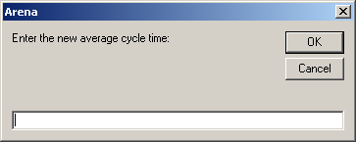
Sample: Assign Variable Value
During Run
Dim oSIMAN As Arena.SIMAN
Dim nVarIndex As Long
Dim sNewValue As String
' Prompt for a new value
sNewValue = InputBox("Enter the new average cycle time:")
' Assign their answer to the Mean Cycle Time variable
Set oSIMAN = ThisDocument.Model.SIMAN
nVarIndex = oSIMAN.SymbolNumber("Mean Cycle Time")
oSIMAN.VariableArrayValue(nVarIndex) = sNewValue

Slide 34
Arena Macro Recorder
A Macro is a VBA function to perform a task.
Macro recording automatically creates the VBA code to reproduce the actions you take while performing the steps in the task.
Use the Record Macro toolbar to start/stop and pause/resume recording.
Useful for automating repetitive tasks.
Ideal for learning VBA commands and prototyping functions.

Slide 35
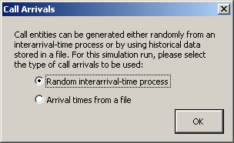
Model 10-05: Presenting Arrival
Choices to the User
Prompt at beginning of run
  Generate entities via random process … or …
  Generate based on arrival times stored in a file

Slide 36
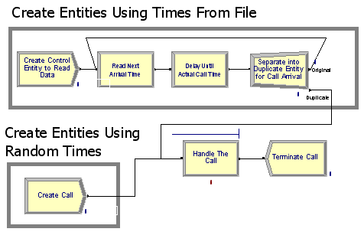
Our Approach
Both sets of logic placed in model window and connected to start of call logic (Process module)

Slide 37
Our Approach (cont’d.)
Change Max Arrivals field in Create module to turn “on” or “off” its generation of entities
Random interarrival-time process
  Create Call module: Infinite
  Create Control Entity to Read Data module: 0
Arrival times from a file
  Create Call module: 0
  Create Control Entity to Read Data module: 1
Give unique “tag” to each Create module (so VBA code can find them)

Slide 38
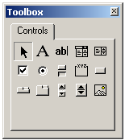
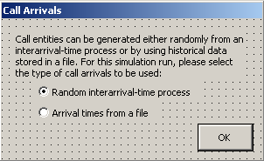
VBA UserForm
Insert/UserForm menu in Visual Basic Editor
Drop controls from Control Toolbox (labels, option buttons, command button)
Label
Option buttons
Command button

Slide 39
Show the UserForm
At beginning of run (ModelLogic_RunBegin), show the form:
Option Explicit
Private Sub ModelLogic_RunBegin()
' Display the UserForm to ask for the type of arrivals
frmArrivalTypeSelection.Show
Exit Sub
End Sub
Program control passes to the form until it’s closed
Arena run “suspended” while form is in control

Slide 40
Change Module Data On OK
When user clicks OK button on form, modify the Create module data
  Find the Create modules
  Set the Max Arrivals fields
  Play a sound
  Close the UserForm
When form is closed, simulation run commences with the new data values in the Create modules

Slide 41
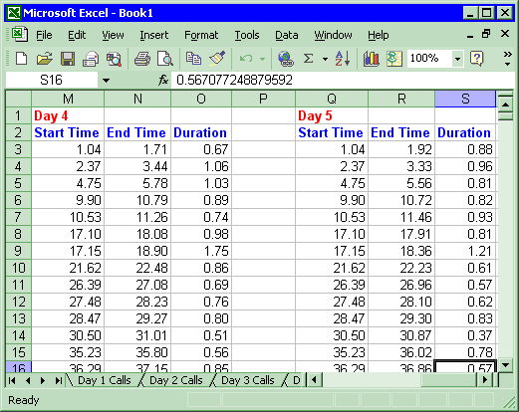
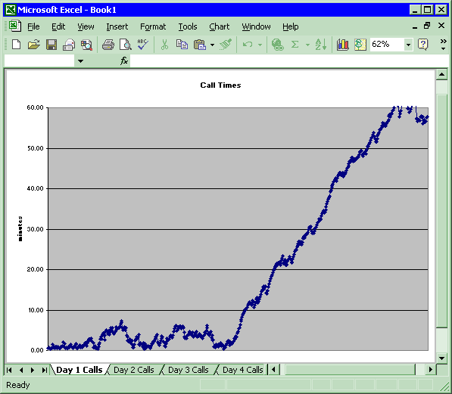
Model 10-06: Record Call Data in Microsoft Excel
Our goal:
  Raw call data tables
  Daily call duration charts

Slide 42
Using ActiveX Automation in VBA
Reference the Excel Object Library
  Tools/References menu in Visual Basic Editor
  Check the Microsoft Excel Object Library
  Establishes link between Arena VBA and Excel
Object variables from application’s object model
  Excel.Application, Excel.Workbook
  Arena.SIMAN
Starting Excel
  CreateObject: starts application, returning “handle” to the program (stored in oExcelApp variable)
  oExcelApp.Workbooks.Add: similar to “File/New” in Excel

Slide 43
Retrieving Simulation Data
ThisDocument
  Built-in variable accessing the Arena model
  Use only within Arena’s VBA
ThisDocument.Model.SIMAN
  Used to access simulation run data
  Browse (F2) in VBA window for full list of variables
  Active only when simulation run data is available -- i.e., built-in events:
    after (and including) ModelLogic_RunBeginSimulation
    before (and including) ModelLogic_RunEndSimulation

Slide 44
Our Approach
VBA ModelLogic_RunBeginSimulation
  Called once at the beginning of the simulation run
    Start Excel with a new spreadsheet (“Workbook”)
    Format header rows for data worksheet
VBA ModelLogic_RunBeginReplication
  Called at the beginning of each replication
    Write headers for the three columns and the Day
    Format the data columns

Slide 45
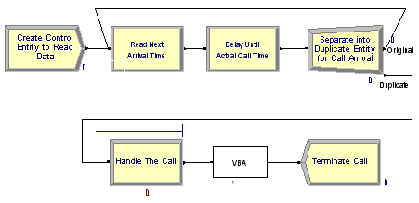
Our Approach (cont’d.)
VBA Module (Blocks panel)
  Insert in model logic just before disposing calls
VBA Code
  VBA modules numbered as they’re placed, with corresponding VBA_Block_<n>_Fire events in VBA

Slide 46
Our Approach (cont’d.)
VBA_Block_1_Fire
  Called each time an entity enters the VBA Block in the model
  Retrieve data from running simulation via SIMAN object (stored in oSIMAN variable)
  Row and columns into which to write data stored in global VBA variables (nNextRow, nColumnA, nColumnB, nColumnC)

Slide 47
Our Approach (cont’d.)
ModelLogic_RunEndReplication
  Called at end of each replication
  Creates the chart and updates the global variables
  Hint: Use Excel macro recording for “skeleton” code (e.g., for formatting commands, creation of chart); copy into Arena VBA and adjust variable names (e.g., add oExcelApp to access Excel)
ModelLogic_RunEndSimulation
  Turn DisplayAlerts off (overwrites .xls file if it exists)
  SaveAs method to give filename
  Excel still running. Could use oExcelApp.Quit

Slide 48
What We’ll Do ...
Reading and Writing Data Files (ReadWrite)
ActiveX™ and Visual Basic® for Applications (VBA)
Creating Modules with Arena Professional Edition

Slide 49
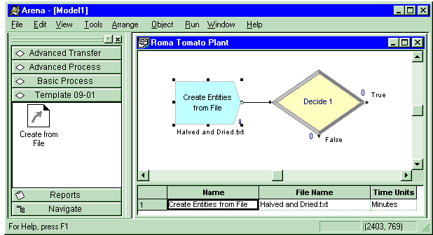
Creating Modules with Arena Professional Edition
Template 10-01:
Create from File module
  Template (.tpo) can be attached and used in Academic Arena
  Place and edit
  like any other
  module
  Need Research/
  Professional Arena
  to create/edit
  template source
  (.tpl)

Slide 50


Panel Icon and User View
Panel Icon: “Button” displayed in template panel to represent the module
User View: Graphics objects placed in the model window with an “instance” of the module
  Module handle
  Entry, exit points
  Animation
  Operand values

Slide 51
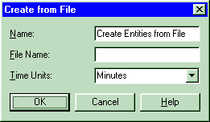
Operands
Operands: Fields that can be filled out by the modeler
  Allow different data for each instance of the same module type in a model
  Passed down to logic via back quotes ( ` )
  Entry and exit point operands permit entities to move through underlying module logic
Operands

Slide 52
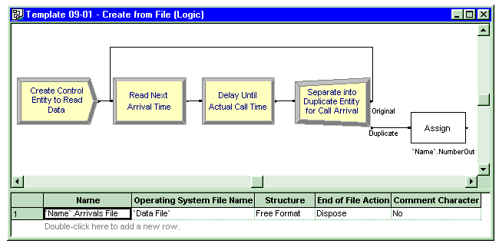
Module Logic
Module Logic: A “submodel” containing module instances
  Can paste from a model into a module definition’s logic window
  Same interface as for building models
Reference to module operand ( `Data File` )
Reference to module operand ( `Name` )

Slide 53
Uses of Templates
Commercial templates
  Arena templates (Basic Process, Advanced Process, etc.)
  Contact Center, Packaging templates
  …
Application-focused templates
  Terminology, modeling capabilities designed for a particular application environment (e.g., mining, material handling, order processing)
  “Personal” / utility templates
  Reuse what you learn
  Share your modeling techniques

Slide 54
Summary
We have just barely scratched the surface of Arena customization and interactions with other software including:
  Reading and writing various types of external data files.
  Visual Basic for Applications
  Interacting with Microsoft Office
  Building custom applications with templates.
There are many other ways of customizing Arena and allowing Arena to interact and exchange data with other software.

